Slide 1
Kerberos
Authentication service developed as part of Project Athena at MIT
A workstation cannot be trusted to identify its users correctly to network services
A user may gain access to a particular workstation and pretend to be another user operating from that workstation
A user may alter the network address of a workstation so that the requests sent from the altered workstation appear to come from the impersonated workstation
A user may eavesdrop on exchanges and use a replay attack to gain entrance to a server or to disrupt operations
Kerberos provides a centralized authentication server whose function is to authenticate users to servers and servers to users
Relies exclusively on symmetric encryption, making no use of public-key encryption
Notes:
Kerberos is an authentication service developed as part of Project Athena at MIT.
The problem that Kerberos addresses is this: Assume an open distributed environment
in which users at workstations wish to access services on servers distributed
throughout the network. We would like for servers to be able to restrict access to
authorized users and to be able to authenticate requests for service. In this environment,
a workstation cannot be trusted to identify its users correctly to network
services. In particular, the following three threats exist:
1. A user may gain access to a particular workstation and pretend to be another
user operating from that workstation.
2. A user may alter the network address of a workstation so that the requests
sent from the altered workstation appear to come from the impersonated
workstation.
3. A user may eavesdrop on exchanges and use a replay attack to gain entrance
to a server or to disrupt operations.
In any of these cases, an unauthorized user may be able to gain access to services
and data that he or she is not authorized to access. Rather than building in elaborate
authentication protocols at each server, Kerberos provides a centralized authentication
server whose function is to authenticate users to servers and servers to users.
Unlike most other authentication schemes described in this book, Kerberos relies
exclusively on symmetric encryption, making no use of public-key encryption.
Two versions of Kerberos are in common use. Version 4 [MILL88, STEI88]
implementations still exist. Version 5 [KOHL94] corrects some of the security deficiencies
of version 4 and has been issued as a proposed Internet Standard (RFC 4120
and RFC 4121).

Slide 2
Kerberos Requirements
The first published report on Kerberos listed the following requirements:
Secure
A network eavesdropper should not be able to obtain the necessary information to impersonate a user
Reliable
Should be highly reliable and should employ a distributed server architecture with one system able to back up another
Transparent
Ideally, the user should not be aware that authentication is taking place beyond the requirement to enter a password
Scalable
The system should be capable of supporting large numbers of clients and servers
Notes:
Kerberos assumes a
distributed client/server architecture and employs one or more Kerberos servers to
provide an authentication service.
The first published report on Kerberos [STEI88] listed the following
requirements.
• Secure: A network eavesdropper should not be able to obtain the necessary
information to impersonate a user. More generally, Kerberos should be strong
enough that a potential opponent does not find it to be the weak link.
• Reliable: For all services that rely on Kerberos for access control, lack of
availability of the Kerberos service means lack of availability of the supported
services. Hence, Kerberos should be highly reliable and should employ a distributed
server architecture with one system able to back up another.
• Transparent: Ideally, the user should not be aware that authentication is taking
place beyond the requirement to enter a password.
• Scalable: The system should be capable of supporting large numbers of clients
and servers. This suggests a modular, distributed architecture.
To support these requirements, the overall scheme of Kerberos is that of a
trusted third-party authentication service that uses a protocol based on that proposed
by Needham and Schroeder [NEED78], which was discussed in Section 15.2.
It is trusted in the sense that clients and servers trust Kerberos to mediate their
mutual authentication. Assuming the Kerberos protocol is well designed, then the
authentication service is secure if the Kerberos server itself is secure.

Slide 3
Kerberos Version 4
Makes use of DES to provide the authentication service
Authentication server (AS)
Knows the passwords of all users and stores these in a centralized database
Shares a unique secret key with each server
Ticket
Created once the AS accepts the user as authentic; contains the user’s ID and network address and the server’s ID
Encrypted using the secret key shared by the AS and the server
Ticket-granting server (TGS)
Issues tickets to users who have been authenticated to AS
Each time the user requires access to a new service the client applies to the TGS using the ticket to authenticate itself
The TGS then grants a ticket for the particular service
The client saves each service-granting ticket and uses it to authenticate its user to a server each time a particular service is requested
Notes:
Version 4 of Kerberos makes use of DES, in a rather elaborate protocol, to provide
the authentication service. Viewing the protocol as a whole, it is difficult to see the
need for the many elements contained therein. Therefore, we adopt a strategy used
by Bill Bryant of Project Athena [BRYA88] and build up to the full protocol by looking
first at several hypothetical dialogues. Each successive dialogue adds additional
complexity to counter security vulnerabilities revealed in the preceding dialogue.
In an unprotected network environment, any
client can apply to any server for service. The obvious security risk is that of impersonation.
An opponent can pretend to be another client and obtain unauthorized
privileges on server machines. To counter this threat, servers must be able to
confirm the identities of clients who request service. Each server can be required to
undertake this task for each client/server interaction, but in an open environment,
this places a substantial burden on each server.
An alternative is to use an authentication server (AS) that knows the passwords
of all users and stores these in a centralized database. In addition, the AS
shares a unique secret key with each server. These keys have been distributed physically
or in some other secure manner.
The AS checks its database to see if the user has supplied the proper
password for this user ID and whether this user is permitted access to server V. If
both tests are passed, the AS accepts the user as authentic and must now convince
the server that this user is authentic. To do so, the AS creates a ticket that contains
the user’s ID and network address and the server’s ID. This ticket is encrypted
using the secret key shared by the AS and this server.
TGS, issues tickets to users who have been authenticated to
AS. Thus, the user first requests a ticket-granting ticket from the AS. The
client module in the user workstation saves this ticket. Each time the user requires
access to a new service, the client applies to the TGS, using the ticket to authenticate
itself. The TGS then grants a ticket for the particular service. The client saves
each service-granting ticket and uses it to authenticate its user to a server each time
a particular service is requested.
Because only the correct user should know the password, only the correct user
can recover the ticket. Thus, we have used the password to obtain credentials from
Kerberos without having to transmit the password in plaintext. The ticket itself
consists of the ID and network address of the user, and the ID of the TGS. This
corresponds to the first scenario. The idea is that the client can use this ticket to
request multiple service-granting tickets. So the ticket-granting ticket is to be reusable.
However, we do not wish an opponent to be able to capture the ticket and
use it. Consider the following scenario: An opponent captures the login ticket and
waits until the user has logged off his or her workstation. Then the opponent either
gains access to that workstation or configures his workstation with the same network
address as that of the victim. The opponent would be able to reuse the ticket
to spoof the TGS. To counter this, the ticket includes a timestamp, indicating the
date and time at which the ticket was issued, and a lifetime, indicating the length
of time for which the ticket is valid (e.g., eight hours). Thus, the client now has a
reusable ticket and need not bother the user for a password for each new service
request. Finally, note that the ticket-granting ticket is encrypted with a secret key
known only to the AS and the TGS. This prevents alteration of the ticket. The ticket
is reencrypted with a key based on the user’s password. This assures that the ticket
can be recovered only by the correct user, providing the authentication.
The service-granting ticket has the same structure as the ticket-granting ticket.
Indeed, because the TGS is a server, we would expect that the same elements are
needed to authenticate a client to the TGS and to authenticate a client to an application
server. Again, the ticket contains a timestamp and lifetime. If the user wants
access to the same service at a later time, the client can simply use the previously
acquired service-granting ticket and need not bother the user for a password. Note
that the ticket is encrypted with a secret key known only to the TGS and the
server, preventing alteration.

Slide 4
The Version 4 Authentication Dialogue
The lifetime associated with the ticket-granting ticket creates a problem:
If the lifetime is very short (e.g., minutes), the user will be repeatedly asked for a password
If the lifetime is long (e.g., hours), then an opponent has a greater opportunity for replay
A network service (the TGS or an application service) must be able to prove that the person using a ticket is the same person to whom that ticket was issued
Servers need to authenticate themselves to users
Notes:
The heart of the first problem is the lifetime associated with the ticket-granting ticket.
If this lifetime is very short (e.g., minutes), then the user will be repeatedly asked
for a password. If the lifetime is long (e.g., hours), then an opponent has a greater
opportunity for replay. An opponent could eavesdrop on the network and capture
a copy of the ticket-granting ticket and then wait for the legitimate user to log out.
Then the opponent could forge the legitimate user’s network address and send the
message of step (3) to the TGS. This would give the opponent unlimited access to
the resources and files available to the legitimate user.
Similarly, if an opponent captures a service-granting ticket and uses it before it
expires, the opponent has access to the corresponding service.
Thus, we arrive at an additional requirement. A network service (the TGS or
an application service) must be able to prove that the person using a ticket is the
same person to whom that ticket was issued.
The second problem is that there may be a requirement for servers to
authenticate themselves to users. Without such authentication, an opponent could
sabotage the configuration so that messages to a server were directed to another
location. The false server would then be in a position to act as a real server and
capture any information from the user and deny the true service to the user.

Slide 5
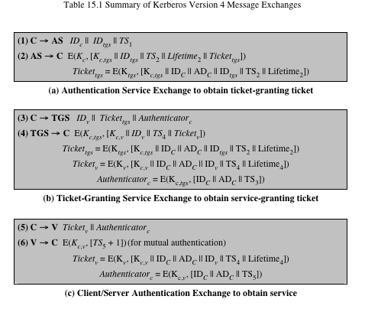
Table 15.1 (page 464 in textbook)
Summary of Kerberos Version 4 Message Exchanges
Notes:
Table 15.1, shows the actual Kerberos protocol.
Table 15.1a shows the technique for distributing the session key. As before,
the client sends a message to the AS requesting access to the TGS. The AS responds
with a message, encrypted with a key derived from the user’s password that
contains the ticket. The encrypted message also contains a copy of the session key,
where the subscripts indicate that this is a session key for C and TGS. Because
this session key is inside the message encrypted with K_{c} , only the user’s client can
read it. The same session key is included in the ticket, which can be read only by
the TGS. Thus, the session key has been securely delivered to both C and the TGS.
Armed with the ticket and the session key, C is ready to approach the TGS.
As before, C sends the TGS a message that includes the ticket plus the ID of the requested
service [message (3) in Table 15.1b].
The reply from the TGS in message (4) follows the form of message (2). The
message is encrypted with the session key shared by the TGS and C and includes
a session key to be shared between C and the server V, the ID of V, and the timestamp
of the ticket. The ticket itself includes the same session key.
C now has a reusable service-granting ticket for V. When C presents this ticket,
as shown in message (5), it also sends an authenticator. The server can decrypt the
ticket, recover the session key, and decrypt the authenticator.
If mutual authentication is required, the server can reply as shown in message
(6) of Table 15.1. The server returns the value of the timestamp from the authenticator,
incremented by 1, and encrypted in the session key. C can decrypt this message
to recover the incremented timestamp. Because the message was encrypted by
the session key, C is assured that it could have been created only by V. The contents
of the message assure C that this is not a replay of an old reply.
Finally, at the conclusion of this process, the client and server share a secret
key. This key can be used to encrypt future messages between the two or to exchange
a new random session key for that purpose.

Slide 6
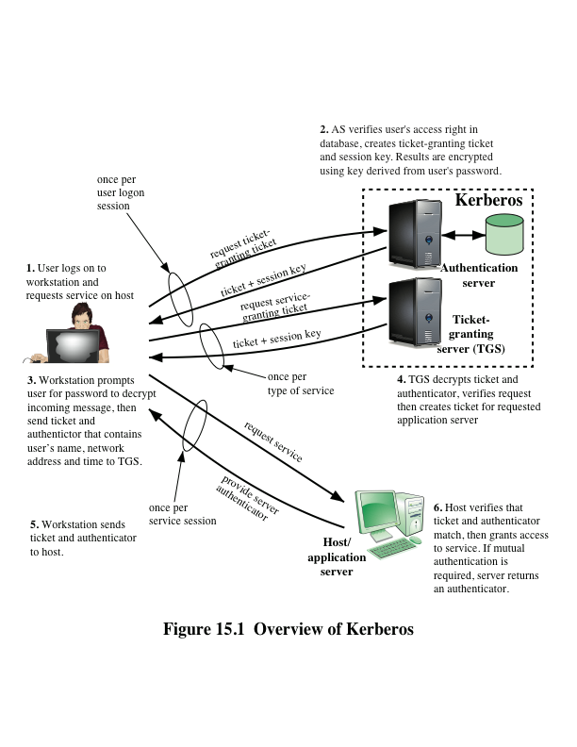
Notes:
Figure 15.1 provides an overview.
First, consider the problem of captured ticket-granting tickets and the need
to determine that the ticket presenter is the same as the client for whom the ticket
was issued. The threat is that an opponent will steal the ticket and use it before it
expires. To get around this problem, let us have the AS provide both the client and
the TGS with a secret piece of information in a secure manner. Then the client can
prove its identity to the TGS by revealing the secret information—again in a secure
manner. An efficient way of accomplishing this is to use an encryption key as the
secure information; this is referred to as a session key in Kerberos.

Slide 7
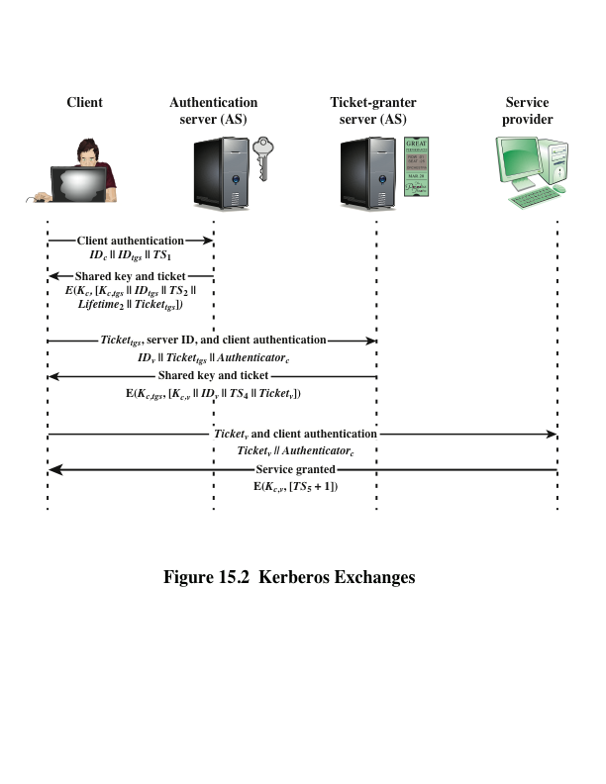
Notes:
Figure 15.2 illustrates the Kerberos exchanges among the parties.

Slide 8
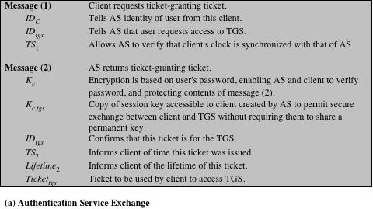
(This table can be found on pages 467 – 468 in the textbook)
Notes:
Table 15.2
summarizes the justification for each of the elements in the Kerberos protocol.
Page 1 – authentication service exchange

Slide 9
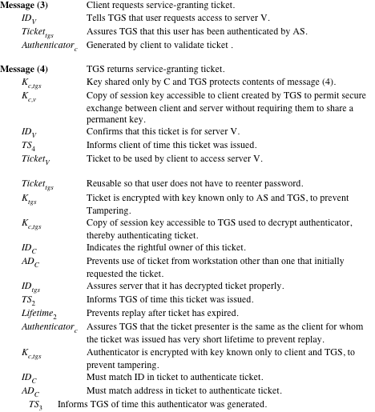
Notes:
Page 2 – ticket-granting service exchange

Slide 10
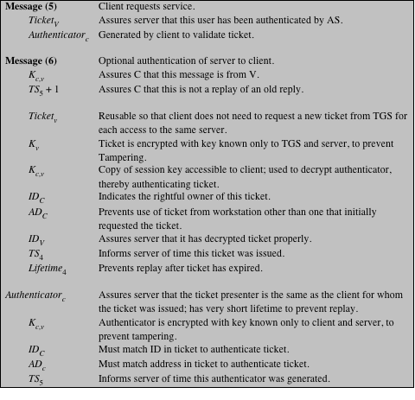
(page 3 of 3)
Notes:
Page 3 – client/server authentication exchange

Slide 11
Kerberos Realms and Multiple Kerberi
A full-service Kerberos environment consisting of a Kerberos server, a number of clients, and a number of application servers requires that:
The Kerberos server must have the user ID and hashed passwords of all participating users in its database; all users are registered with the Kerberos server
The Kerberos server must share a secret key with each server; all servers are registered with the Kerberos server
The Kerberos server in each interoperating realm shares a secret key with the server in the other realm; the two Kerberos servers are registered with each other
Notes:
A full-service Kerberos environment
consisting of a Kerberos server, a number of clients, and a number of application
servers requires the following:
1. The Kerberos server must have the user ID and hashed passwords of all participating
users in its database. All users are registered with the Kerberos server.
2. The Kerberos server must share a secret key with each server. All servers are
registered with the Kerberos server.
Networks of clients and servers under different administrative organizations
typically constitute different realms. That is, it generally is not practical or does not
conform to administrative policy to have users and servers in one administrative
domain registered with a Kerberos server elsewhere. However, users in one realm
may need access to servers in other realms, and some servers may be willing to provide
service to users from other realms, provided that those users are authenticated.
Kerberos provides a mechanism for supporting such interrealm authentication.
For two realms to support interrealm authentication, a third requirement is added:
3. The Kerberos server in each interoperating realm shares a secret key with the
server in the other realm. The two Kerberos servers are registered with each other.
The scheme requires that the Kerberos server in one realm trust the Kerberos
server in the other realm to authenticate its users. Furthermore, the participating
servers in the second realm must also be willing to trust the Kerberos server in the
first realm.

Slide 12
Kerberos Realm
A set of managed nodes that share the same Kerberos database
The database resides on the Kerberos master computer system, which should be kept in a physically secure room
A read-only copy of the Kerberos database might also reside on other Kerberos computer systems
All changes to the database must be made on the master computer system
Changing or accessing the contents of a Kerberos database requires the Kerberos master password
Notes:
A Kerberos realm is a set of managed nodes that
share the same Kerberos database. The Kerberos database resides on the Kerberos
master
computer system, which should be kept in a physically secure room. A read-only
copy of the Kerberos database might also reside on other Kerberos computer
systems. However, all changes to the database must be made on the master computer
system. Changing or accessing the contents of a Kerberos database requires
the Kerberos master password.

Slide 13
Kerberos Principal
Three parts of a principal name
A service or user name
An instance name
A realm name
A service or user that is known to the Kerberos system
Identified by its principal name
Notes:
A related concept is that of a Kerberos principal ,
which is a service or user that is known to the Kerberos system. Each Kerberos
principal is identified by its principal name. Principal names consist of three parts: a
service or user name, an instance name, and a realm name.

Slide 14
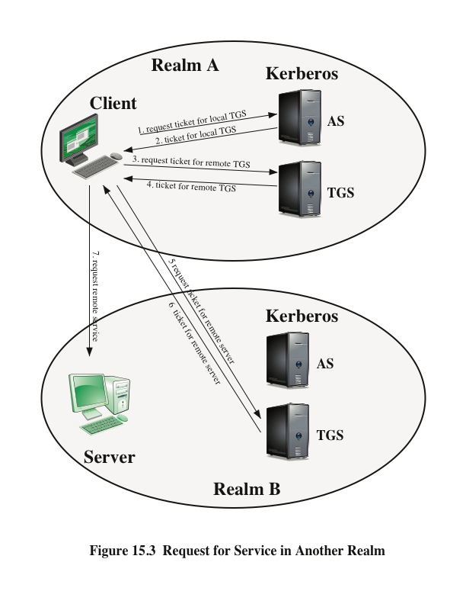
Notes:
With these ground rules in place, we can describe the mechanism as follows
(Figure 15.3): A user wishing service on a server in another realm needs a ticket for
that server. The user’s client follows the usual procedures to gain access to the local
TGS and then requests a ticket-granting ticket for a remote TGS (TGS in another
realm). The client can then apply to the remote TGS for a service-granting ticket for
the desired server in the realm of the remote TGS.

Slide 15
Differences Between Versions 4 and 5
Version 5 is intended to address the limitations of version 4 in two areas:
Environmental shortcomings
Encryption system dependence
Internet protocol dependence
Message byte ordering
Ticket lifetime
Authentication forwarding
Interrealm authentication
Technical deficiencies
Double encryption
PCBC encryption
Session keys
Password attacks
Notes:
Version 5 is intended to address the limitations
of version 4 in two areas: environmental shortcomings and technical deficiencies.
Let us briefly summarize the improvements in each area.
Kerberos version 4 was developed for use within the Project Athena environment
and, accordingly, did not fully address the need to be of general purpose. This
led to the following environmental shortcomings .
1. Encryption system dependence: Version 4 requires the use of DES. Export
restriction on DES as well as doubts about the strength of DES were thus of
concern. In version 5, ciphertext is tagged with an encryption-type identifier so
that any encryption technique may be used. Encryption keys are tagged with a
type and a length, allowing the same key to be used in different algorithms and
allowing the specification of different variations on a given algorithm.
2. Internet protocol dependence: Version 4 requires the use of Internet Protocol
(IP) addresses. Other address types, such as the ISO network address, are not
accommodated. Version 5 network addresses are tagged with type and length,
allowing any network address type to be used.
3. Message byte ordering: In version 4, the sender of a message employs a byte
ordering of its own choosing and tags the message to indicate least significant
byte in lowest address or most significant byte in lowest address. This techniques
works but does not follow established conventions. In version 5, all message
structures are defined using Abstract Syntax Notation One (ASN.1) and
Basic Encoding Rules (BER), which provide an unambiguous byte ordering.
4. Ticket lifetime: Lifetime values in version 4 are encoded in an 8-bit quantity
in units of five minutes. Thus, the maximum lifetime that can be expressed is
2⁸ * 5 = 1280 minutes (a little over 21 hours). This may be inadequate for
some applications (e.g., a long-running simulation that requires valid Kerberos
credentials throughout execution). In version 5, tickets include an explicit start
time and end time, allowing tickets with arbitrary lifetimes.
5. Authentication forwarding: Version 4 does not allow credentials issued to one
client to be forwarded to some other host and used by some other client. This
capability would enable a client to access a server and have that server access
another server on behalf of the client. For example, a client issues a request to
a print server that then accesses the client’s file from a file server, using the client’s
credentials for access. Version 5 provides this capability.
6. Interrealm authentication: In version 4, interoperability among N realms
requires on the order of N² Kerberos-to-Kerberos relationships, as described
earlier. Version 5 supports a method that requires fewer relationships, as
described shortly.
Apart from these environmental limitations, there are technical deficiencies
in the version 4 protocol itself. Most of these deficiencies were documented in
[BELL90], and version 5 attempts to address these. The deficiencies are the following.
1. Double encryption: Note in Table 15.1 [messages (2) and (4)] that tickets provided
to clients are encrypted twice—once with the secret key of the target
server and then again with a secret key known to the client. The second encryption
is not necessary and is computationally wasteful.
2. PCBC encryption: Encryption in version 4 makes use of a nonstandard mode of
DES known as propagating cipher block chaining (PCBC). It has been demonstrated
that this mode is vulnerable to an attack involving the interchange of ciphertext
blocks [KOHL89]. PCBC was intended to provide an integrity check as
part of the encryption operation. Version 5 provides explicit integrity mechanisms,
allowing the standard CBC mode to be used for encryption. In particular, a checksum
or hash code is attached to the message prior to encryption using CBC.
3. Session keys: Each ticket includes a session key that is used by the client to
encrypt the authenticator sent to the service associated with that ticket. In addition,
the session key may subsequently be used by the client and the server
to protect messages passed during that session. However, because the same
ticket may be used repeatedly to gain service from a particular server, there is
the risk that an opponent will replay messages from an old session to the client
or the server. In version 5, it is possible for a client and server to negotiate a
subsession key, which is to be used only for that one connection. A new access
by the client would result in the use of a new subsession key.
4. Password attacks: Both versions are vulnerable to a password attack. The message
from the AS to the client includes material encrypted with a key based
on the client’s password.10 An opponent can capture this message and attempt
to decrypt it by trying various passwords. If the result of a test decryption is
of the proper form, then the opponent has discovered the client’s password
and may subsequently use it to gain authentication credentials from Kerberos.
This is the same type of password attack described in Chapter 21, with the
same kinds of countermeasures being applicable. Version 5 does provide a
mechanism known as pre-authentication, which should make password attacks
more difficult, but it does not prevent them.

Slide 16
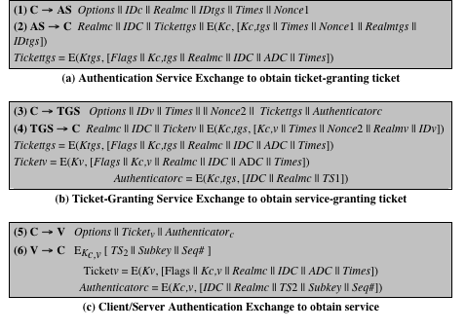
Table 15.3
Summary of Kerberos Version 5 Message Exchanges
Notes:
Table 15.3 summarizes the basic version
5 dialogue. This is best explained by comparison with version 4 (Table 15.1).

Slide 17
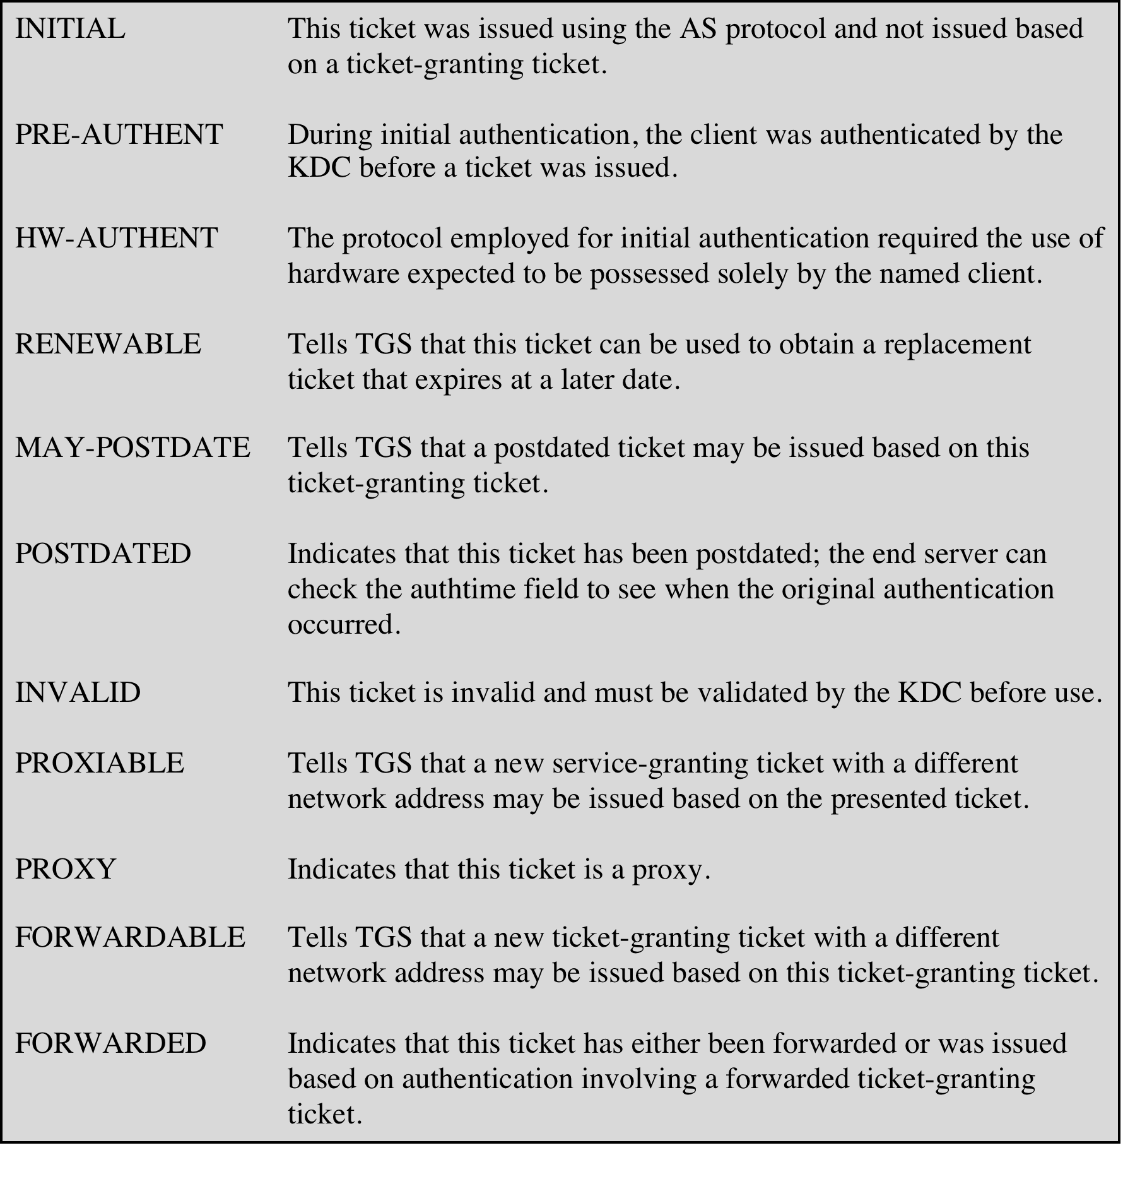
Table 15.4
Kerberos Version 5 Flags
(Table can be found on page 474 in textbook)
Notes:
The flags field included in tickets in version 5 supports expanded
functionality compared to that available in version 4. Table 15.4 summarizes the
flags that may be included in a ticket.

Slide 18
Mutual Authentication
Public-key encryption for session key distribution
Assumes each of the two parties is in possession of the current public key of the other
May not be practical to require this assumption
Denning protocol using timestamps
Uses an authentication server (AS) to provide public-key certificates
Requires the synchronization of clocks
Woo and Lam makes use of nonces
Care needed to ensure no protocol flaws
Notes:
In Chapter 14, we presented one approach to the use of public-key encryption for
the purpose of session-key distribution (Figure 14.9). This protocol assumes that
each of the two parties is in possession of the current public key of the other. It may
not be practical to require this assumption.
A protocol using timestamps is provided in [DENN81]
In this case, the central system is referred to as an authentication server (AS),
because it is not actually responsible for secret-key distribution. Rather, the AS provides
public-key certificates. The session key is chosen and encrypted by A; hence,
there is no risk of exposure by the AS. The timestamps protect against replays of
compromised keys.
This protocol is compact but, as before, requires the synchronization of clocks.
Another approach, proposed by Woo and Lam [WOO92a], makes use of nonces.
This seems to be a secure protocol that takes into account the various attacks.
However, the authors themselves spotted a flaw and submitted a revised version of
the algorithm.
In both this example and the protocols described earlier, protocols that appeared
secure were revised after additional analysis. These examples highlight the
difficulty of getting things right in the area of authentication.

Slide 19
One-Way Authentication
Have public-key approaches for e-mail
Encryption of message for confidentiality, authentication, or both
The public-key algorithm must be applied once or twice to what may be a long message
For confidentiality encrypt message with one-time secret key, public-key encrypted
If authentication is the primary concern, a digital signature may suffice
Notes:
We have already presented public-key encryption approaches that are suited to electronic mail, including the straightforward encryption of the entire message for confidentiality (Figure 12.1b), authentication (Figure 12.1c), or both (Figure 12.1d). These approaches require that either the sender know the recipient's public key (confidentiality) or the recipient know the sender's public key (authentication) or both (confidentiality plus authentication). In addition, the public-key algorithm must be applied once or twice to what may be a long message.
If confidentiality is the primary concern, then better to encrypt the message with a one-time secret key, and also encrypt this one-time key with B's public key. If authentication is the primary concern, then a digital signature may suffice (but could be replaced by an opponent). To counter such a scheme, both the message and signature can be encrypted with the recipient's public key. The latter two schemes require that B know A's public key and be convinced that it is timely. An effective way to provide this assurance is the digital certificate.
If authentication is the primary concern, then a digital signature may suffice.

Slide 20
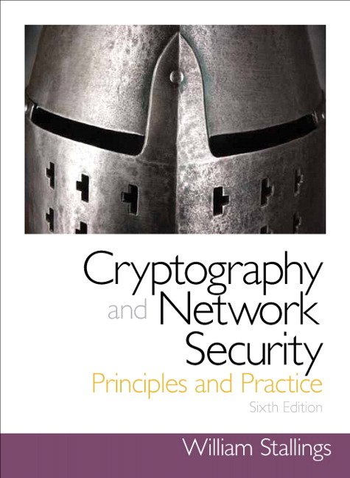
Summary
Remote user-authentication principles
Mutual authentication
One-way authentication
Remote user-authentication using symmetric encryption
Mutual authentication
One-way authentication
Kerberos
Motivation
Kerberos V4 and V5
Remote user-authentication using asymmetric encryption
Mutual authentication
One-way authentication
Notes:
Chapter 15 summary.

